Slide 1



Patterns & Frameworks for Service Access & Communication : Part 1
Douglas C. Schmidt
d.schmidt@vanderbilt.edu
www.dre.vanderbilt.edu/~schmidt
Professor of Computer Science
Institute for Software Integrated Systems Vanderbilt University Nashville, Tennessee, USA

Slide 2

Topics Covered in this Part of the Module
Summarize the accidental complexities with Socket API
Section 1 has a summary of the functionality of the Socket API

Slide 3
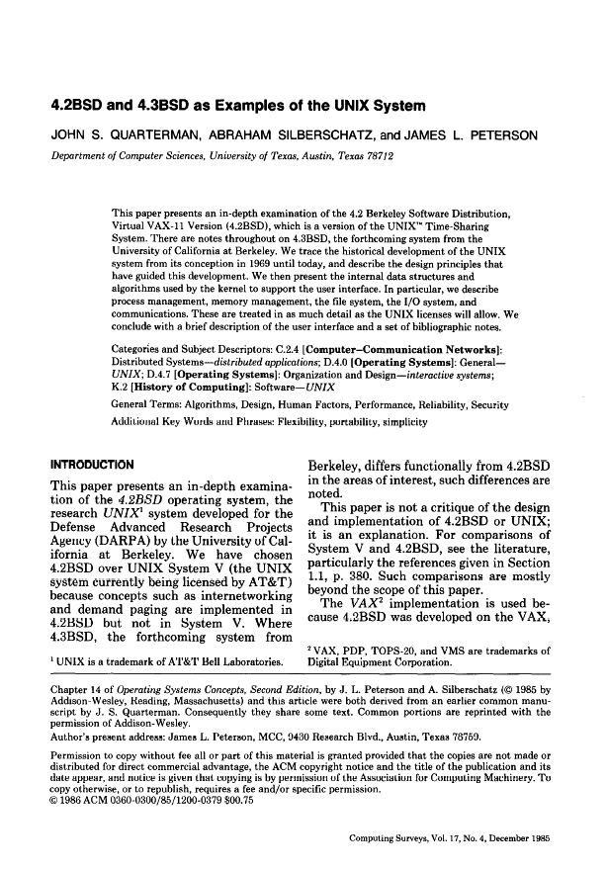
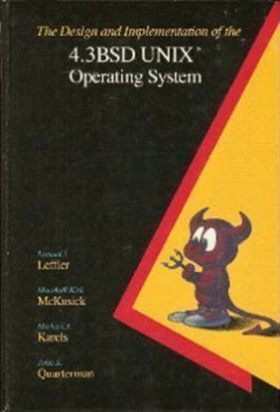
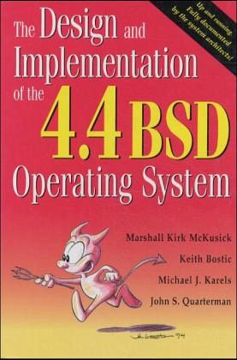
Recap of the Sockets API
Originally developed in BSD UNIX as a C language interface to the TCP/IP protocol suite
Highly influential in hastening the “Internet Revolution”
The Sockets network programming API is available on most operating systems
Notes:
http://www.flickr.com/photos/40567541@N08/8203770880/

Slide 4
Recap of the Sockets API
send()
recv()
bind()
read()
write()
readv()
listen()
writev()
socket()
accept()
sendto()
connect()
recvmsg()
sendmsg()
recvfrom()
setsockopt()
getsockopt()
getpeername()
getsockname()
gethostbyname()
getservbyname()
...
Originally developed in BSD UNIX as a C language interface to the TCP/IP protocol suite
The Socket API has approximately two dozen functions
See en.wikipedia.org/wiki/Berkeley_sockets for more info on the Sockets API

Slide 5
Recap of the Sockets API
socket handles
Originally developed in BSD UNIX as a C language interface to the TCP/IP protocol suite
The Socket API has approximately two dozen functions
A socket is a handle created by the OS that is associated with an end point of a communication channel
The Sockets API
PF_INET Sockets
SOCK_ STREAM
SOCK_ DGRAM
SOCK_ RAW
TCP
UDP
IP
Network Interface

Slide 6


Recap of the Sockets API
Originally developed in BSD UNIX as a C language interface to the TCP/IP protocol suite
The Socket API has approximately two dozen functions
A socket is a handle created by the OS that is associated with an end point of a communication channel
A socket can be bound to a local or remote address
e.g., a TCP/UDP port number & IP address
Remote address
Local address
Socket
Socket

Slide 7

Recap of the Sockets API
Originally developed in BSD UNIX as a C language interface to the TCP/IP protocol suite
The Socket API has approximately two dozen functions
A socket is a handle created by the OS that is associated with an end point of a communication channel
A socket can be bound to a local or remote address
Sockets are often used to create bi-directional “reliable” communication links between software processes
e.g., via TCP/IP
Socket
Socket
TCP/IP
Notes:
http://www.flickr.com/photos/52736525@N07/8044851757, http://www.flickr.com/photos/39747297@N05/5229733647/

Slide 8
Accidental Complexities with Socket API
Poorly structured, non-uniform, & non-portable
API is linear rather than hierarchical
Not structured according to different phases of connection lifecycle & the roles played by participants
No consistency among names
send()
recv()
bind()
read()
write()
readv()
listen()
writev()
socket()
accept()
sendto()
connect()
recvmsg()
sendmsg()
recvfrom()
setsockopt()
getsockopt()
getpeername()
getsockname()
gethostbyname()
getservbyname()
...

Slide 9
Accidental Complexities with Socket API
Poorly structured, non-uniform, & non-portable
API is linear rather than hierarchical
Not structured according to different phases of connection lifecycle & the roles played by participants
No consistency among names
Non-portable & error-prone
Function names & semantics − Different on different systems, e.g.:
send() & recv() used for file & socket I/O on POSIX, but only for socket I/O on Windows
accept() can take 0 client addr parameter on UNIX/Windows, but crashes old RTOS platforms
send()
recv()
bind()
read()
write()
readv()
listen()
writev()
socket()
accept()
sendto()
connect()
recvmsg()
sendmsg()
recvfrom()
setsockopt()
getsockopt()
getpeername()
getsockname()
gethostbyname()
getservbyname()
...

Slide 10
Accidental Complexities with Socket API
Poorly structured, non-uniform, & non-portable
API is linear rather than hierarchical
Not structured according to different phases of connection lifecycle & the roles played by participants
No consistency among names
Non-portable & error-prone
Function names & semantics − Different on different systems, e.g.:
send() & recv() used for file & socket I/O on POSIX, but only for socket I/O on Windows
accept() can take 0 client addr parameter on UNIX/Windows, but crashes old RTOS platforms
Socket handle representations − Different platforms represent sockets differently
e.g., int on UNIX vs. pointer on Windows
send()
recv()
bind()
read()
write()
readv()
listen()
writev()
socket()
accept()
sendto()
connect()
recvmsg()
sendmsg()
recvfrom()
setsockopt()
getsockopt()
getpeername()
getsockname()
gethostbyname()
getservbyname()
...

Slide 11
Accidental Complexities with Socket API
Poorly structured, non-uniform, & non-portable
API is linear rather than hierarchical
Not structured according to different phases of connection lifecycle & the roles played by participants
No consistency among names
Non-portable & error-prone
Function names & semantics − Different on different systems, e.g.:
send() & recv() used for file & socket I/O on POSIX, but only for socket I/O on Windows
accept() can take 0 client addr parameter on UNIX/Windows, but crashes old RTOS platforms
Socket handle representations − Different platforms represent sockets differently
e.g., int on UNIX vs. pointer on Windows
Header files − Platforms use different paths/names
send()
recv()
bind()
read()
write()
readv()
listen()
writev()
socket()
accept()
sendto()
connect()
recvmsg()
sendmsg()
recvfrom()
setsockopt()
getsockopt()
getpeername()
getsockname()
gethostbyname()
getservbyname()
...

Slide 12
Accidental Complexities with Socket API
Lack of type safety
I/O handles not amenable to strong type checking at compile time
e.g., no type distinction between a socket used for passive listening & a socket used for data transfer
send()
recv()
bind()
read()
write()
readv()
listen()
writev()
socket()
accept()
sendto()
connect()
recvmsg()
sendmsg()
recvfrom()
setsockopt()
getsockopt()
getpeername()
getsockname()
gethostbyname()
getservbyname()
...

Slide 13
Accidental Complexities with Socket API
Lack of type safety
I/O handles not amenable to strong type checking at compile time
e.g., no type distinction between a socket used for passive listening & a socket used for data transfer
send()
recv()
bind()
read()
write()
readv()
listen()
writev()
socket()
accept()
sendto()
connect()
recvmsg()
sendmsg()
recvfrom()
setsockopt()
getsockopt()
getpeername()
getsockname()
gethostbyname()
getservbyname()
...
Steep learning curve due to complex semantics
Multiple protocol families & address families
Options for infrequently features, e.g., multicast & broadcast, async & nonblocking I/O, urgent data delivery

Slide 14
Accidental Complexities with Socket API
Lack of type safety
I/O handles not amenable to strong type checking at compile time
e.g., no type distinction between a socket used for passive listening & a socket used for data transfer
send()
recv()
bind()
read()
write()
readv()
listen()
writev()
socket()
accept()
sendto()
connect()
recvmsg()
sendmsg()
recvfrom()
setsockopt()
getsockopt()
getpeername()
getsockname()
gethostbyname()
getservbyname()
...
Steep learning curve due to complex semantics
Multiple protocol families & address families
Options for infrequently features, e.g., multicast & broadcast, async & nonblocking I/O, urgent data delivery
Many low-level details
Forgetting to use network byte order for port numbers
Forgetting to initialize C structures, e.g., sockaddr
Possibility of omitting a function, such as listen()
Possibility of mismatch between protocol & address families due to decoupled usage

Slide 15
Example of Socket API Accidental Complexities
Most of these problems won’t be detected by the compiler!
1 #include <sys/types.h>
2 #include <sys/socket.h>
3
4 const int PORT_NUM = 10000;
5
6 int echo_server ()
7 {
8 struct sockaddr_in addr;
9 int addr_len;
10 char buf[BUFSIZ];
11 int d_handle;
12 // Create the local endpoint.
Possible differences in header file names
Forgot to initialize to sizeof (sockaddr_in) to 0
Use of non-portable handle type

Slide 16
Example of Socket API Accidental Complexities
Meant to say SOCK_STREAM
13 int a_handle = socket (PF_UNIX, SOCK_DGRAM, 0);
14 if (a_handle == -1) return -1;
15
16 // Set up address information where server listens.
17 addr.sin_family = AF_INET;
18 addr.sin_port = PORT_NUM;
19 addr.sin_addr.addr = INADDR_ANY;
20
21 if (bind (a_handle, (struct sockaddr *) &addr,
22 sizeof addr) == -1)
23 return -1;
24
Use of non-portable return value
Protocol & address family mismatch
May be wrong byte order
Structure fields not completely zeroed out

Slide 17
Example of Socket API Accidental Complexities
Forgot call to listen() before accept()
25 // Create a new communication endpoint.
26 if (d_handle = accept (a_handle, (struct sockaddr *) &addr,
27 &addr_len) != -1) {
28 int n;
29 while ((n = read (a_handle, buf, sizeof buf)) > 0)
30 write (d_handle, buf, n);
31
32 close (d_handle);
33 }
34 return 0;
35 }
Can’t call accept() on SOCK_DGRAM
Reading from wrong handle
No guarantee that “n” bytes will be written
These types of problems are all too common with the Sockets API

Slide 18
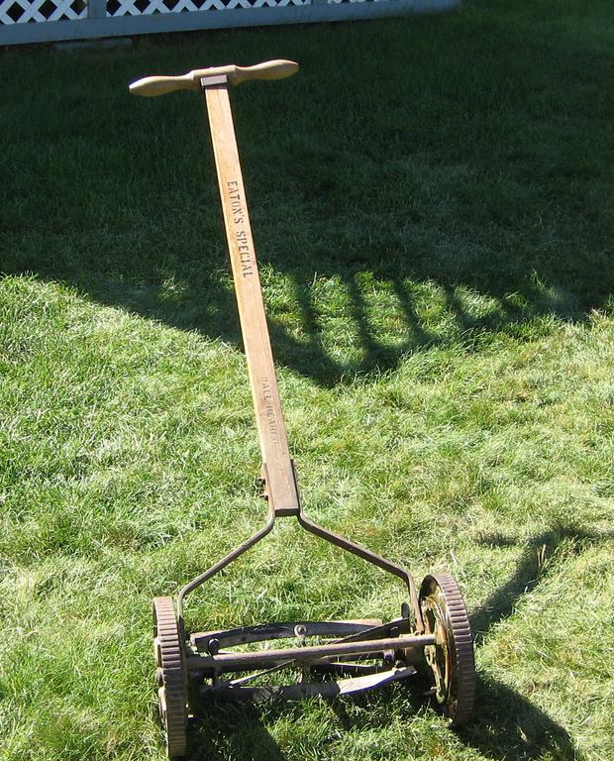
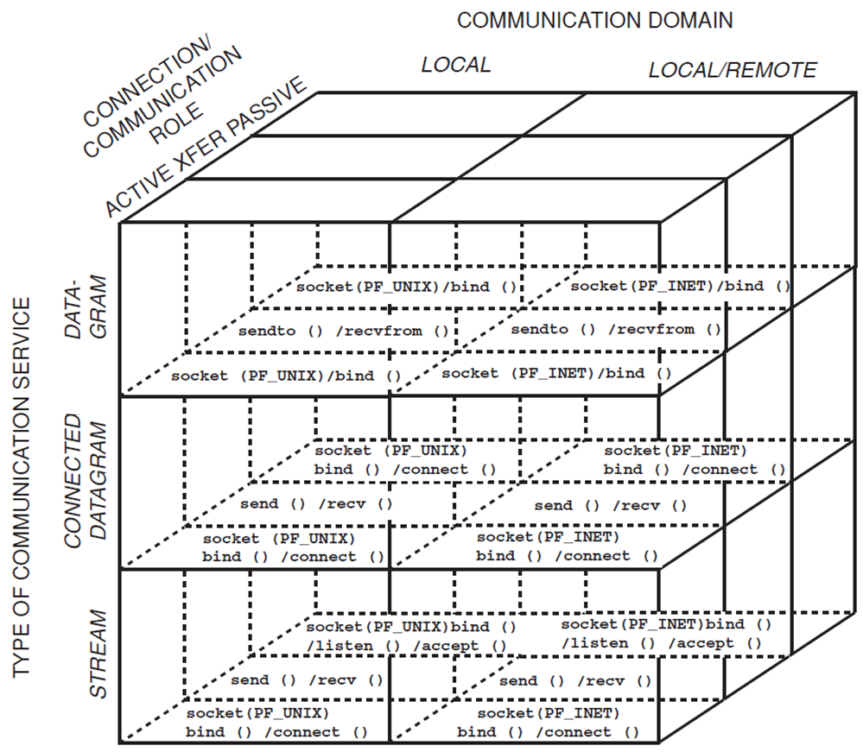
Summary
The native Socket API suffers from many accidental complexities
e.g., it’s tedious, error-prone, overly complex, & non-portable/ non-uniform

Slide 19

Summary
The native Socket API suffers from many accidental complexities
e.g., it’s tedious, error-prone, overly complex, & non-portable/ non-uniform
Although our analysis focused on the Socket API, this critique also applies to other native OS systems programming APIs defined using C
C APIs
Thread
Library
Stream
Pipes
Sockets /TLI
Named
Pipes
Select /Poll
Dynamic
Linking
Memory
Mapping
System
V IPC
Process/Thread
Subsystem
Communication
Subsystem
Virtual Memory
Subsystem
General POSIX, Windows, & RTOS Services
See www.dre.vanderbilt.edu/~schmidt/PDF/C++-wrappers.pdf for more info

Slide 20
Patterns & Frameworks for Service Access & Communication: Part 2
Douglas C. Schmidt
d.schmidt@vanderbilt.edu
www.dre.vanderbilt.edu/~schmidt
Professor of Computer Science
Institute for Software Integrated Systems Vanderbilt University Nashville, Tennessee, USA

Slide 21
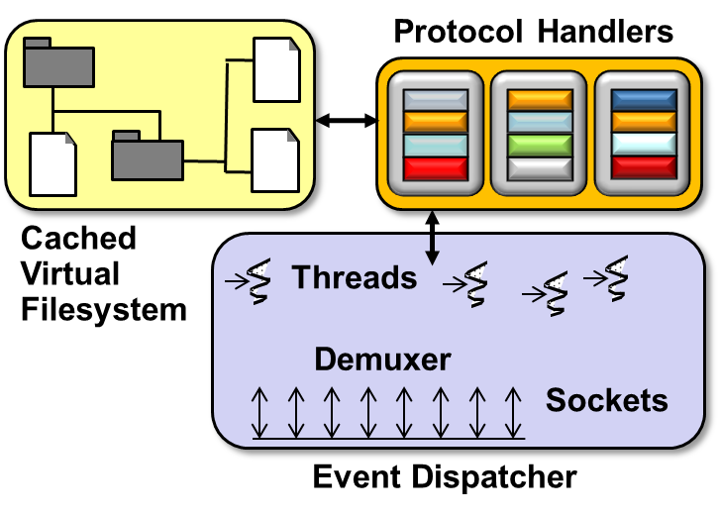
Topics Covered in this Part of the Module
Summarize the accidental complexities with Socket API
Describe how the Wrapper Façade pattern can alleviate accidental complexities with C APIs for JAWS
Wrapper
Facades
Solaris
VxWorks
Windows
Linux
LynxOS

Slide 22
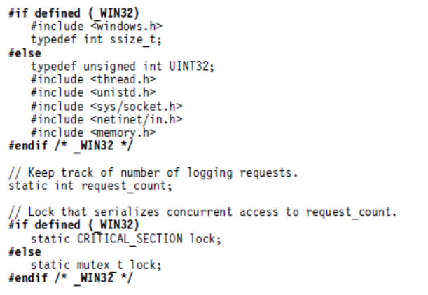
Encapsulating Low-level OS APIs
Context | Problem
Web servers must manage various OS services e.g., processes, threads, connections, memory, files, etc. | Programming directly to low-level OS APIs is tedious, error-prone, & non-portable due accidental complexities
Web Server
Solaris
VxWorks
Windows
Linux
LynxOS

Slide 23
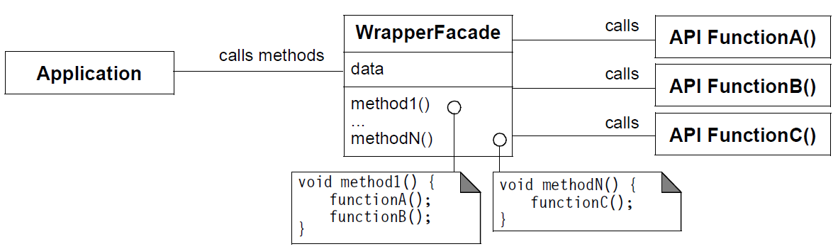
Encapsulating Low-level OS APIs
Context | Problem | Solution
Web servers must manage various OS services e.g., processes, threads, connections, memory, files, etc. | Programming directly to low-level OS APIs is tedious, error-prone, & non-portable due accidental complexities | Apply the Wrapper Facade pattern to avoid accessing low-level operating system APIs directly
Wrapper Façade encapsulates data & functions provided by existing C APIs within more concise, robust, portable, maintainable, & cohesive object-oriented classes
Structure

Slide 24
Encapsulating Low-level OS APIs
Context | Problem | Solution
Web servers must manage various OS services e.g., processes, threads, connections, memory, files, etc. | Programming directly to low-level OS APIs is tedious, error-prone, & non-portable due accidental complexities | Apply the Wrapper Facade pattern to avoid accessing low-level operating system APIs directly
Wrapper Façade encapsulates data & functions provided by existing C APIs within more concise, robust, portable, maintainable, & cohesive object-oriented classes
Structure

Slide 25
Encapsulating Low-level OS APIs
Context | Problem | Solution
Web servers must manage various OS services e.g., processes, threads, connections, memory, files, etc. | Programming directly to low-level OS APIs is tedious, error-prone, & non-portable due accidental complexities | Apply the Wrapper Facade pattern to avoid accessing low-level operating system APIs directly
Wrapper Façade encapsulates data & functions provided by existing C APIs within more concise, robust, portable, maintainable, & cohesive object-oriented classes
Structure

Slide 26
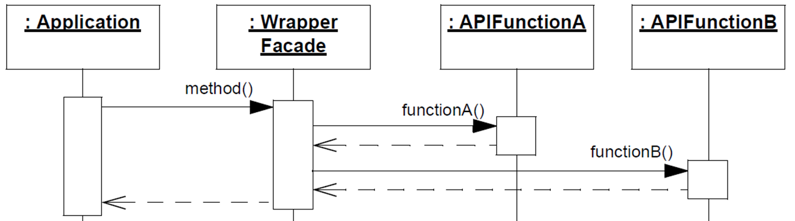
Encapsulating Low-level OS APIs
Context | Problem | Solution
Web servers must manage various OS services e.g., processes, threads, connections, memory, files, etc. | Programming directly to low-level OS APIs is tedious, error-prone, & non-portable due accidental complexities | Apply the Wrapper Facade pattern to avoid accessing low-level operating system APIs directly
Dynamics
The structure & dynamics look similar to Bridge & Proxy, but the implementation is typically lighter weight
See www.dre.vanderbilt.edu/~schmidt/PDF/wrapper-facade.pdf for info

Slide 27
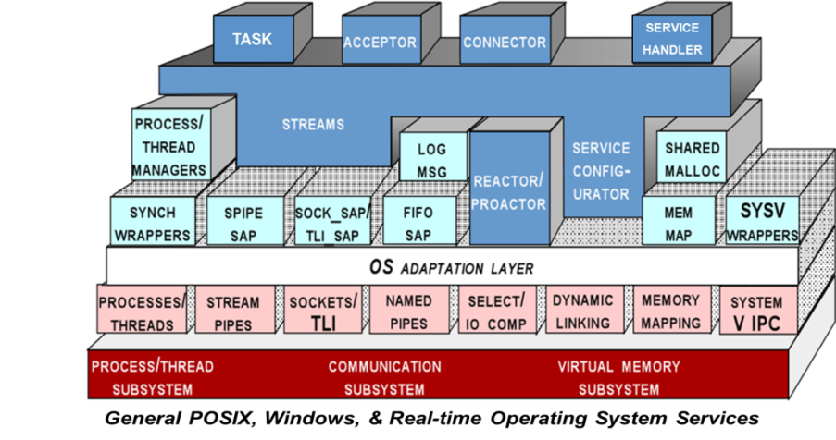
Applying the Wrapper Façade Pattern in JAWS
JAWS uses the wrapper facades defined by ACE to ensure it can run on many OS platforms
e.g., Windows, UNIX, & many real-time operating systems
C++ Wrapper Facades

Slide 28
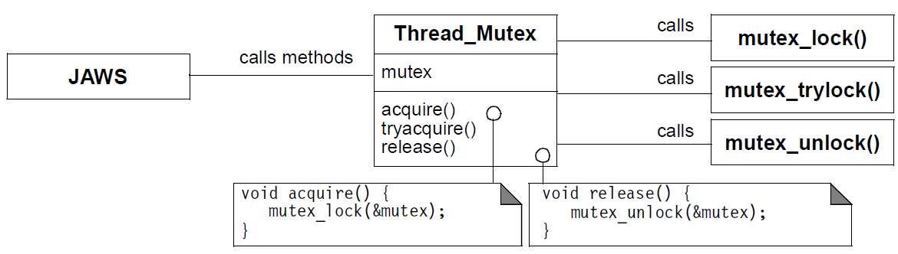
Applying the Wrapper Façade Pattern in JAWS
JAWS uses the wrapper facades defined by ACE to ensure it can run on many OS platforms
e.g., Windows, UNIX, & many real-time operating systems
JAWS uses the ACE_Thread_Mutex wrapper facade in ACE to portably access mutual exclusion mechanisms provided by various operating systems

Slide 29
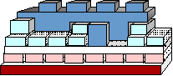
Applying the Wrapper Façade Pattern in JAWS
JAWS uses the wrapper facades defined by ACE to ensure it can run on many OS platforms
e.g., Windows, UNIX, & many real-time operating systems
JAWS uses the ACE_Thread_Mutex wrapper facade in ACE to portably access mutual exclusion mechanisms provided by various operating systems
Other ACE wrapper facades used in JAWS encapsulate sockets, process & thread management, memory-mapped & regular files, explicit dynamic linking, etc.

Slide 30
Benefits of the Wrapper Façade Pattern
Concise & robust higher- level OO programming interfaces
Reduce the tedium & increase the type-safety of developing apps, which decreases certain types of accidental complexities
Wrapper
Facades
Solaris
VxWorks
Windows
Linux
LynxOS

Slide 31
Benefits of the Wrapper Façade Pattern
Concise & robust higher- level OO programming interfaces
Reduce the tedium & increase the type-safety of developing apps, which decreases certain types of accidental complexities
Portability & maintainability
Shield app developers from non- portable aspects of lower-level APIs
Wrapper
Facades
Solaris
VxWorks
Windows
Linux
LynxOS

Slide 32
Benefits of the Wrapper Façade Pattern
Concise & robust higher- level OO programming interfaces
Reduce the tedium & increase the type-safety of developing apps, which decreases certain types of accidental complexities
Portability & maintainability
Shield app developers from non- portable aspects of lower-level APIs
Modularity, reusability, & configurability
Creates cohesive & reusable class components that can be ‘plugged’ into other components in a wholesale fashion
e.g., using OO language features like inheritance & parameterized types
Wrapper
Facades
Solaris
VxWorks
Windows
Linux
LynxOS

Slide 33
Limitations of the Wrapper Façade Pattern
Loss of functionality
Whenever a portable abstraction is layered on top of an existing API it’s possible to lose functionality
Wrapper
Facades
Solaris
VxWorks
Windows
Linux
LynxOS

Slide 34
Limitations of the Wrapper Façade Pattern
Loss of functionality
Whenever a portable abstraction is layered on top of an existing API it’s possible to lose functionality
Performance degradation
Performance can degrade if many forwarding function calls and/or indirections are made per wrapper façade method
Wrapper
Facades
Solaris
VxWorks
Windows
Linux
LynxOS

Slide 35
Limitations of the Wrapper Façade Pattern
Loss of functionality
Whenever a portable abstraction is layered on top of an existing API it’s possible to lose functionality
Performance degradation
Performance can degrade if many forwarding function calls and/or indirections are made per wrapper façade method
Programming language & compiler limitations
May be hard to define wrapper facades for certain languages due to a lack of language support or limitations with compilers
Wrapper
Facades
Solaris
VxWorks
Windows
Linux
LynxOS

Slide 36
Patterns & Frameworks for Service Access & Communication: Part 3
Douglas C. Schmidt
d.schmidt@vanderbilt.edu
www.dre.vanderbilt.edu/~schmidt
Professor of Computer Science
Institute for Software Integrated Systems Vanderbilt University Nashville, Tennessee, USA

Slide 37
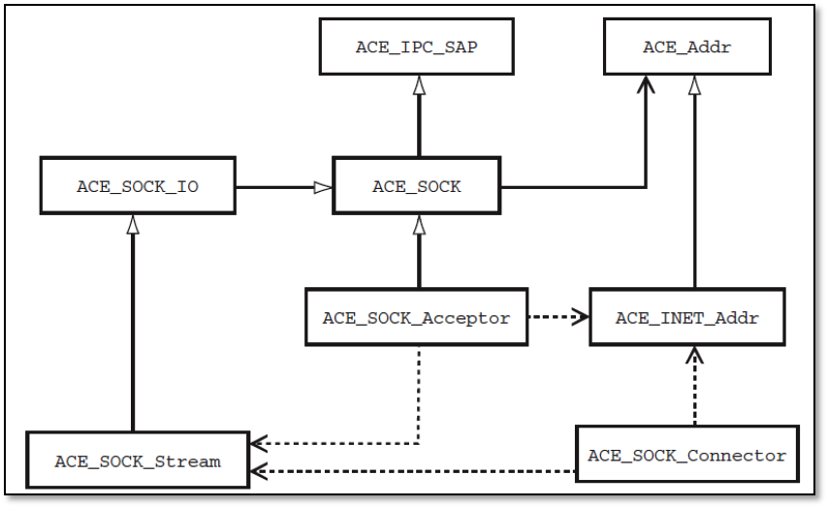
Topics Covered in this Part of the Module
Summarize the accidental complexities with Socket API
Describe how the Wrapper Façade pattern can alleviate accidental complexities with C APIs for JAWS
Describe the ACE C++ Socket wrapper façades

Slide 38
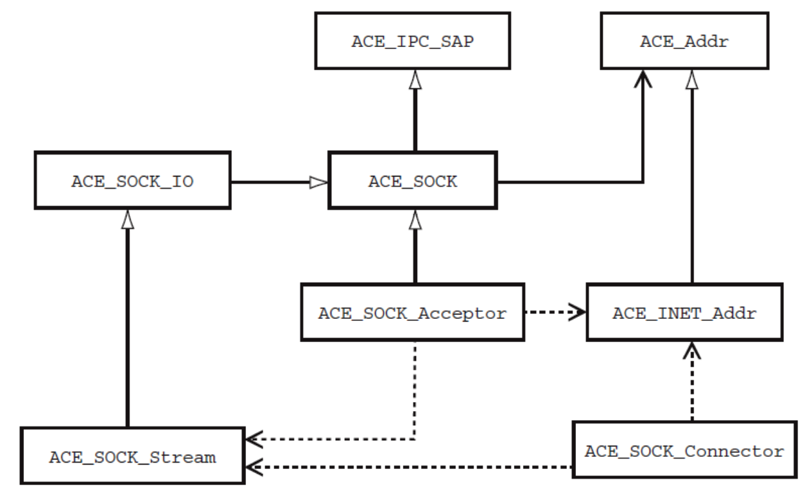
ACE Socket Wrapper Façade Classes
ACE defines a set of C++ classes that address limitations with Socket API
Building blocks for higher-level abstractions
Simplify common use cases
Enhance type-safety
Ensure portability
These classes are designed in accordance with the Wrapper Facade pattern

Slide 39
ACE Socket Wrapper Façade Classes
ACE defines a set of C++ classes that address limitations with Socket API
Building blocks for higher-level abstractions
Simplify common use cases
Enhance type-safety
Ensure portability
ACE Class | Description
ACE_INET_Addr | Encapsulates the Internet-domain address family
ACE_SOCK_IO ACE_SOCK_Stream | Encapsulate the data transfer mechanisms supported by data-mode sockets
ACE_SOCK_Connector | A factory that connects to a peer acceptor & then initializes a new endpoint of communication in an ACE_SOCK_Stream object
ACE_SOCK_Acceptor | A factory that initializes a new endpoint of communication in an ACE_SOCK_Stream object in response to a connection request from a peer connector

Slide 40
ACE Socket Wrapper Façade Classes
ACE defines a set of C++ classes that address limitations with Socket API
Building blocks for higher-level abstractions
Simplify common use cases
Enhance type-safety
Ensure portability
ACE Class | Description
ACE_INET_Addr | Encapsulates the Internet-domain address family
ACE_SOCK_IO ACE_SOCK_Stream | Encapsulate the data transfer mechanisms supported by data-mode sockets
ACE_SOCK_Connector | A factory that connects to a peer acceptor & then initializes a new endpoint of communication in an ACE_SOCK_Stream object
ACE_SOCK_Acceptor | A factory that initializes a new endpoint of communication in an ACE_SOCK_Stream object in response to a connection request from a peer connector

Slide 41
ACE Socket Wrapper Façade Classes
ACE defines a set of C++ classes that address limitations with Socket API
Building blocks for higher-level abstractions
Simplify common use cases
Enhance type-safety
Ensure portability
ACE Class | Description
ACE_INET_Addr | Encapsulates the Internet-domain address family
ACE_SOCK_IO ACE_SOCK_Stream | Encapsulate the data transfer mechanisms supported by data-mode sockets
ACE_SOCK_Connector | A factory that connects to a peer acceptor & then initializes a new endpoint of communication in an ACE_SOCK_Stream object
ACE_SOCK_Acceptor | A factory that initializes a new endpoint of communication in an ACE_SOCK_Stream object in response to a connection request from a peer connector

Slide 42
ACE Socket Wrapper Façade Classes
ACE defines a set of C++ classes that address limitations with Socket API
Building blocks for higher-level abstractions
Simplify common use cases
Enhance type-safety
Ensure portability
ACE Class | Description
ACE_INET_Addr | Encapsulates the Internet-domain address family
ACE_SOCK_IO ACE_SOCK_Stream | Encapsulate the data transfer mechanisms supported by data-mode sockets
ACE_SOCK_Connector | A factory that connects to a peer acceptor & then initializes a new endpoint of communication in an ACE_SOCK_Stream object
ACE_SOCK_Acceptor | A factory that initializes a new endpoint of communication in an ACE_SOCK_Stream object in response to a connection request from a peer connector
See www.dre.vanderbilt.edu/~schmidt/PDF/Socket-Wrappers.pdf for more info

Slide 43
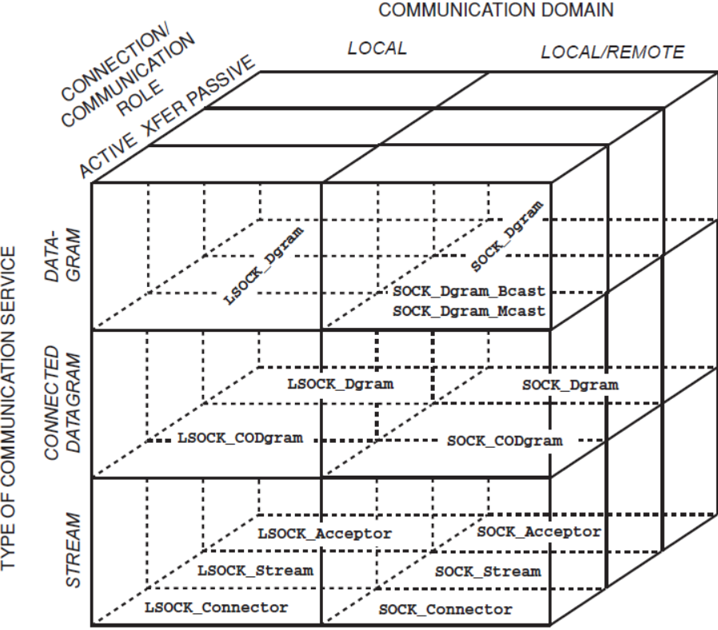
ACE Socket Wrapper Façades Taxonomy
Type of communication service
e.g., streams vs. datagrams vs. connected datagrams

Slide 44
ACE Socket Wrapper Façades Taxonomy
Type of communication service
e.g., streams vs. datagrams vs. connected datagrams
Connection & communication role
e.g., clients often initiate connections actively, whereas servers often accept them passively

Slide 45
ACE Socket Wrapper Façades Taxonomy
Type of communication service
e.g., streams vs. datagrams vs. connected datagrams
Connection & communication role
e.g., clients often initiate connections actively, whereas servers often accept them passively
Communication domain
e.g., local host only vs. local or remote host

Slide 46
ACE Socket Wrapper Façades Taxonomy
Type of communication service
e.g., streams vs. datagrams vs. connected datagrams
Connection & communication role
e.g., clients often initiate connections actively, whereas servers often accept them passively
Communication domain
e.g., local host only vs. local or remote host
Each of these types, roles, & domains are codified in the OO class design

Slide 47
ACE Socket Wrapper Façades Taxonomy
ACE Socket wrapper façade structure reflects the domain of networked IPC & provide the following capabilities:
ACE_SOCK_* classes encapsulate Internet-domain Socket API functionality

Slide 48
ACE Socket Wrapper Façades Taxonomy
ACE Socket wrapper façade structure reflects the domain of networked IPC & provide the following capabilities:
ACE_SOCK_* classes encapsulate Internet-domain Socket API functionality
ACE_LSOCK_* classes encapsulate Local Socket (UNIX-domain) API functionality
ACE also has wrapper facades for unicast, multicast, broadcast datagrams

Slide 49
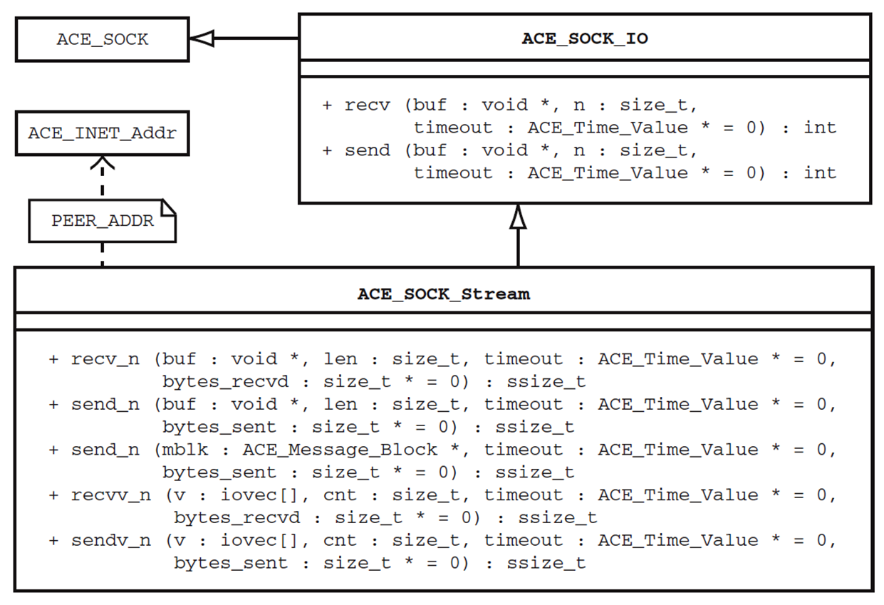
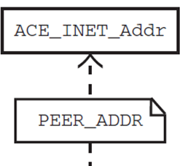
The ACE_SOCK_Stream Class
Encapsulates data transfer mechanisms of data-mode sockets to support:
Sending & receiving up to n bytes or exactly n bytes
“Scatter-read” & “gather- write'' operations
Blocking, non- blocking, & timed I/O operations
C++ traits support generic programming & enable whole-sale replace-ment of IPC functionality

Slide 50
Sidebar: Traits for ACE IPC Wrapper Facades
ACE Socket wrapper facades use traits to define the following dependencies in a generic manner
PEER_ADDR – This trait defines the ACE_INET_Addr class associated with the ACE Socket Wrapper Façade
PEER_STREAM – This trait defines the ACE_SOCK_Stream data transfer class associated with the ACE_SOCK_Acceptor & ACE_SOCK_Connector factories

Slide 51
Sidebar: Traits for ACE IPC Wrapper Facades
ACE Socket wrapper facades use traits to define the following dependencies in a generic manner
PEER_ADDR – This trait defines the ACE_INET_Addr class associated with the ACE Socket Wrapper Façade
PEER_STREAM – This trait defines the ACE_SOCK_Stream data transfer class associated with the ACE_SOCK_Acceptor & ACE_SOCK_Connector factories
e.g., traits for Socket & TLI wrappers have different dependencies
class ACE_SOCK_Stream {
public:
typedef ACE_INET_Addr
PEER_ADDR;
// ...
class ACE_TLI_Stream {
public:
typedef ACE_INET_Addr
PEER_ADDR;
// ...

Slide 52
Sidebar: Traits for ACE IPC Wrapper Facades
ACE Socket wrapper facades use traits to define the following dependencies in a generic manner
PEER_ADDR – This trait defines the ACE_INET_Addr class associated with the ACE Socket Wrapper Façade
PEER_STREAM – This trait defines the ACE_SOCK_Stream data transfer class associated with the ACE_SOCK_Acceptor & ACE_SOCK_Connector factories
e.g., traits for Socket & TLI wrappers have different dependencies
Traits make it easier to write generic algorithms & containers
class ACE_SOCK_Stream {
public:
typedef ACE_INET_Addr
PEER_ADDR;
// ...
class ACE_TLI_Stream {
public:
typedef ACE_INET_Addr
PEER_ADDR;
// ...
See erdani.com/publications/traits.html for more on C++ traits

Slide 53
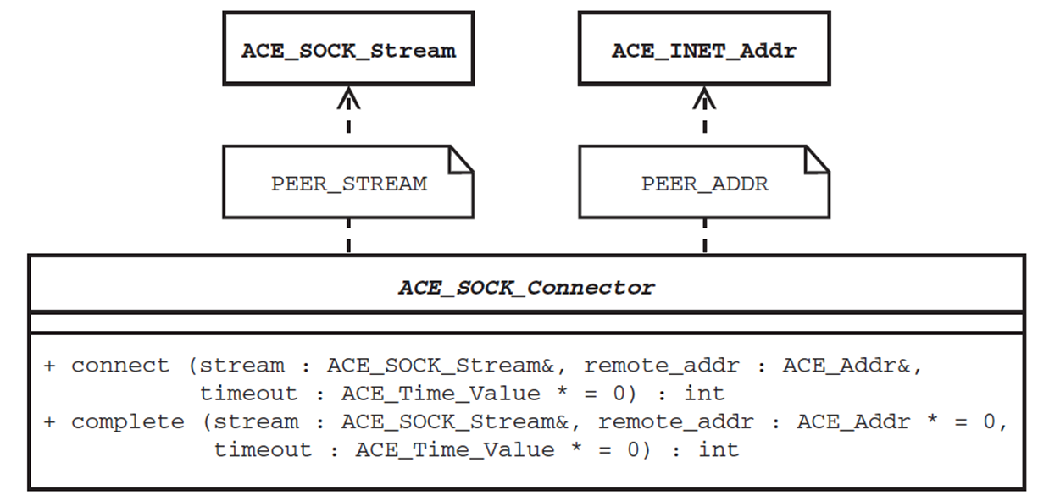
The ACE_SOCK_Connector Class
A factory that actively establishes a new endpoint of communication by
Initiating a connection with a peer acceptor & after connection is established then initialize an ACE_SOCK_Stream object
Connection initiation can be blocking, non-blocking, or timed
C++ traits support generic programming & enable wholesale replacement of IPC functionality

Slide 54
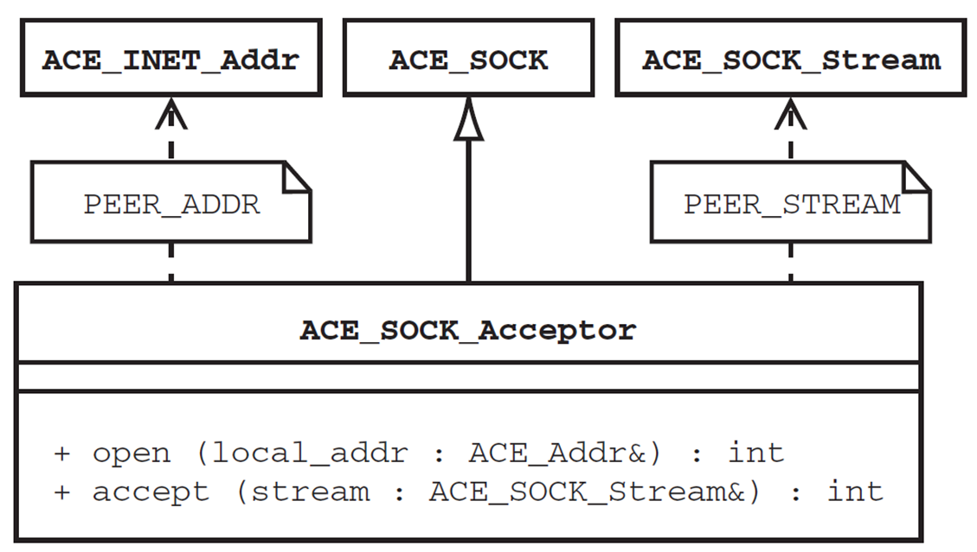
The ACE_SOCK_Acceptor Class
A factory that passively establishes a new endpoint of communication by
Accepting a connection from a peer connector & then initializing an ACE_SOCK_Stream object after the connection is established
Connections accepts can be blocking, non-blocking, or timed
C++ traits support generic programming & enable whole-sale replace-ment of IPC functionality

Slide 55
Summary
There is a confusing asymmetry in the Socket API between (1) connection roles & (2) socket modes
e.g., an application may accidentally call send() or recv() on a data-mode socket handle before it's connected
int buggy_echo_client (u_short port_num, const char *s)
{
int handle = socket (PF_UNIX, SOCK_DGRAM, 0);
send (handle, s, strlen (s) + 1);
sockaddr_in s_addr;
memset (&s_addr, 0, sizeof s_addr);
s_addr.sin_family = AF_INET;
s_addr.sin_port = htons (port_num);
connect (handle, (sockaddr *) &s_addr, sizeof s_addr);
}
Operations called in wrong order, but C Socket APIs can’t prevent this

Slide 56
Summary
There is a confusing asymmetry in the Socket API between (1) connection roles & (2) socket modes
e.g., an application may also accidentally call send() or recv() on a listen-mode socket handle
int buggy_echo_server (u_short port_num) {
int a_socket = socket (PF_UNIX, SOCK_DGRAM, 0);
listen (a_socket), 5);
...
int handle = accept (a_socket, 0, 0);
for (char buf[BUFSIZ];;) {
ssize_t n = read (a_socket, buf, sizeof buf);
if (n <= 0) break;
write (handle, buf, n);
...
Reading from acceptor handle!

Slide 57
Summary
There is a confusing asymmetry in the Socket API between (1) connection roles & (2) socket modes
e.g., an application may also accidentally call send() or recv() on a listen-mode socket handle
The ACE Socket wrapper facades ensure these errors are detected by the compiler, rather than at runtime
int buggy_echo_server (u_short port_num) {
int a_socket = socket (PF_UNIX, SOCK_DGRAM, 0);
listen (a_socket), 5);
...
int handle = accept (a_socket, 0, 0);
for (char buf[BUFSIZ];;) {
ssize_t n = read (a_socket, buf, sizeof buf);
if (n <= 0) break;
write (handle, buf, n);
...
Reading from acceptor handle!

Slide 58
Patterns & Frameworks for Service Access & Communication: Part 4
Douglas C. Schmidt
d.schmidt@vanderbilt.edu
www.dre.vanderbilt.edu/~schmidt
Professor of Computer Science
Institute for Software Integrated Systems Vanderbilt University Nashville, Tennessee, USA

Slide 59
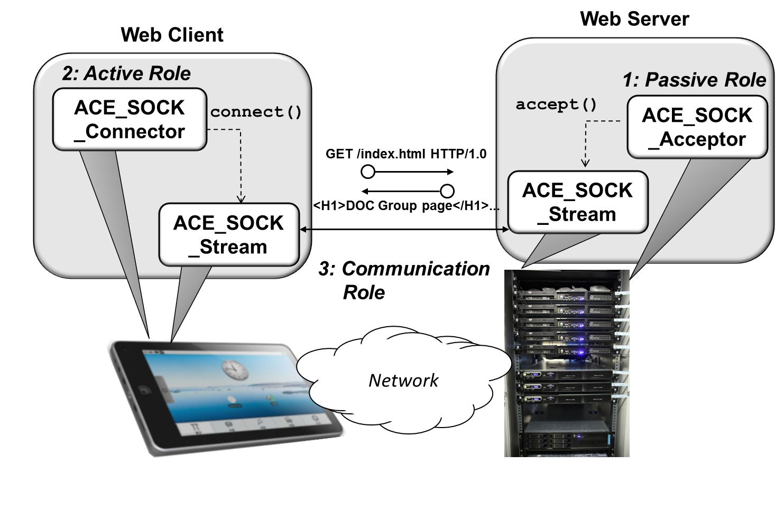
Topics Covered in this Part of the Module
Summarize the accidental complexities with Socket API
Describe how the Wrapper Façade pattern can alleviate accidental complexities with C APIs for JAWS
Describe the ACE C++ Socket wrapper façades
Apply the ACE C++ Socket wrapper facades to a simple iterative web client/server

Slide 60

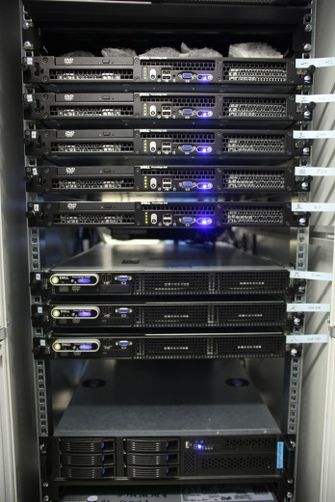
ACE Socket Wrapper Facades for Web Client/Server
2: Active Role
1: Passive Role
ACE_SOCK _Connector
ACE_SOCK _Acceptor
Web Client
Web Server
Network
Played by a peer application that accepts a connection from a remote peer
Played by a peer application that initiates a connection to a remote peer

Slide 61
ACE Socket Wrapper Facades for Web Client/Server
2: Active Role
Played by both peer apps to exchange data after they are connected
1: Passive Role
ACE_SOCK _Connector
accept()
ACE_SOCK _Acceptor
connect()
GET /index.html HTTP/1.0
ACE_SOCK _Stream
ACE_SOCK _Stream
Web Client
<H1>DOC Group page</H1>...
Web Server
3: Communication Role
Network
Played by a peer application that accepts a connection from a remote peer
Played by a peer application that initiates a connection to a remote peer

Slide 62
Using ACE_SOCK_Connector for a Web Client
An ACE_SOCK_Connector can connect a client app to a web server
Process command-line args
int main (int argc, char *argv[]) {
str::string pathname = argc > 1 ? argv[1] : "/index.html";
std::string server_hostname =
argc > 2 ? argv[2] : "www.dre.vanderbilt.edu";
typedef ACE_SOCK_Connector CONNECTOR;
CONNECTOR connector;
CONNECTOR::PEER_STREAM peer;
CONNECTOR::PEER_ADDR peer_addr (80, server_hostname.c_str());
ACE_Time_Value timeout (10); // 10 second timeout.
if (connector.connect (peer, peer_addr, &timeout) == -1)
return 1;
... // Defined later
Instantiate the connector, data transfer, & address objects
Block up to 10 seconds to establish connection or detect failure

Slide 63
Using ACE_SOCK_Stream for a Web Server
An ACE_SOCK_Stream can send & receive data to & from a web server
// ... Continue from ACE_SOCK_Connector code shown above ...
char buf[BUFSIZ];
iovec iov[3];
iov[0].iov_base = (char *) "GET ";
iov[0].iov_len = 4; // Length of "GET ".
iov[1].iov_base = (char *) pathname.c_str();
iov[1].iov_len = pathname.length();
iov[2].iov_base = (char *) " HTTP/1.0\r\n\r\n";
iov[2].iov_len = 13; // Length of " HTTP/1.0\r\n\r\n";
if (peer.sendv_n (iov, 3) == -1) return 1;
ACE_Time_Value timeout (10); // 10 second timeout
for (ssize_t n; (n = peer.recv (buf, sizeof buf, &timeout)) > 0; )
ACE::write_n (ACE_STDOUT, buf, n);
...
Initialize the iovec vector for gather-write I/O
Perform blocking gather-write on ACE_SOCK_Stream
Perform timed read on ACE_SOCK_Stream

Slide 64
Using ACE_SOCK_Acceptor for a Web Server
An ACE_SOCK_Acceptor & ACE_SOCK_Stream can accept connections & send/receive data to/from a web client
Instantiate the acceptor, data transfer, & address objects & listen for connections on port 80
int main (){
typedef ACE_SOCK_Acceptor ACCEPTOR;
ACCEPTOR::PEER_ADDR server_addr (80);
ACCEPTOR acceptor;
if (acceptor.open (server_addr) == -1) return 1;
for (ACCEPTOR::PEER_STREAM peer;;) {
if (acceptor.accept (peer) == -1) return 1;
std::string pathname (get_pathname (peer));
ACE_Mem_Map mapped_file (pathname.c_str ());
if (peer.send_n (mapped_file.addr (), mapped_file.size ()) == -1) return 1;
...
Accept a new connection
Memory map requested file
Return requested data (could use timed send to avoid blocking for extended duration)

Slide 65
Summary
The ACE Socket wrapper facades resolve the following problems with the Socket API :
Error-Prone − The ACE Socket wrapper facades operations are type-safe
int a_handle = socket(...);
listen(a_handle);
...
read(a_handle, ...);
int d_handle = accept(a_handle, ...);
accept(d_handle, ...);
This erroneous code compiles!

Slide 66
Summary
The ACE Socket wrapper facades resolve the following problems with the Socket API :
Error-Prone − The ACE Socket wrapper facades operations are type-safe
ACE_SOCK_Acceptor acceptor;
ACE_SOCK_Stream stream;
...
acceptor.read(...);
...
stream.accept(...);
int a_handle = socket(...);
listen(a_handle);
...
read(a_handle, ...);
int d_handle = accept(a_handle, ...);
accept(d_handle, ...);
This erroneous code won’t compile!

Slide 67
Summary
The ACE Socket wrapper facades resolve the following problems with the Socket API :
Error-Prone − The ACE Socket wrapper facades operations are type-safe
Overly complex − “Surface area” is minimized by clustering wrapper facades into classes for actively connecting, passively accepting, & transferring data

Slide 68
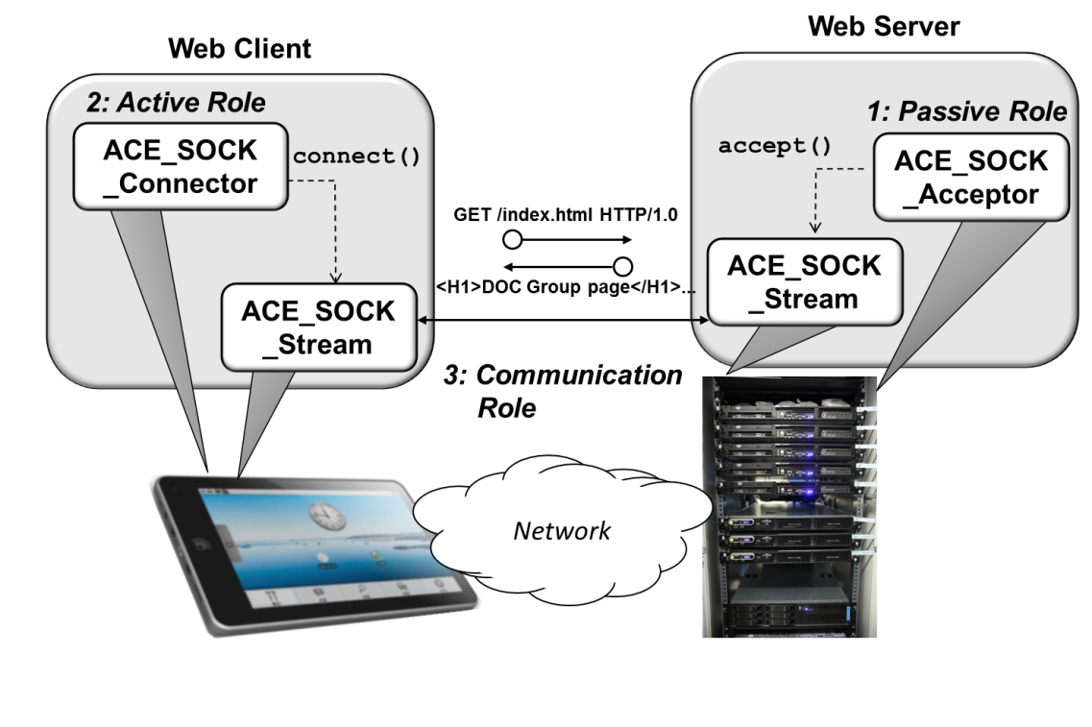
Summary
The ACE Socket wrapper facades resolve the following problems with the Socket API :
Error-Prone − The ACE Socket wrapper facades operations are type-safe
Overly complex − “Surface area” is minimized by clustering wrapper facades into classes for actively connecting, passively accepting, & transferring data
Non-portable & non-uniform − The client app & web server source code compiles & runs correctly & efficiently on all platforms that ACE supports
We need more than just wrapper facades to develop effective web servers!

